Slide 1
Easy Translate
Spam Bytes

Slide 2
Team
Karan Megha
Het Shah
Aniket Bhoi
Bhargavi Chauhan

Slide 3
Agenda
To develop an application to translate English-based educational resources into vernacular languages (mother-tongues) using Natural Language Processing (NLP) for mass-effective learning.

Slide 4


Introduction
Process information contained in natural language text
Also known as Computational Linguistics (CL), Human Language Technology (HLT), Natural Language Engineering

Slide 5
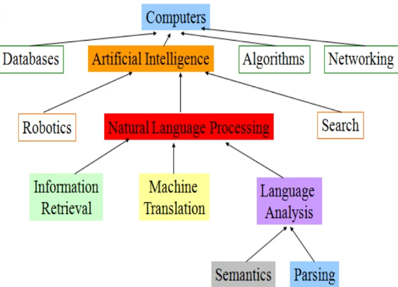
Chart

Slide 6

AI and natural language processing may well make the internet far more useful than it is today.
Vint Cerf,
Google Vice President

Slide 7
Timeline
Designing Front-end by using React native
1
Linking Google Translate API
2
Building an application Using Android studio
3
That’s it!!
4

Slide 8
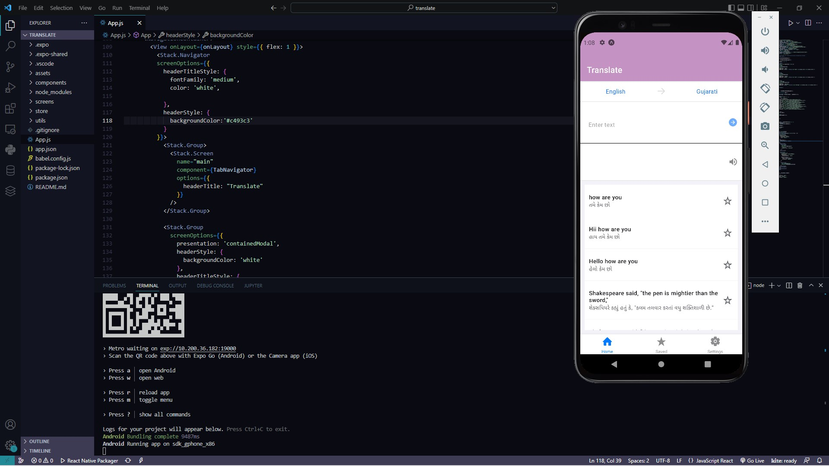
Content

Slide 9



Summary
Human level or human readable natural language processing is an Al-complete problem.
It is equivalent to solving the central artificial intelligence problem and making computers as intelligent as people.
Make computers as they can solve problems like humans and think like humans as well as perform activities that humans cant perform and making it more efficient than humans

Slide 10
Thank you
Spam Bytes
https://github.com/KaranMegha/translate_app

